Slide 1

The Machine Learning Process
Python 101 – Control flow
Sathish Ravichandran

Slide 2
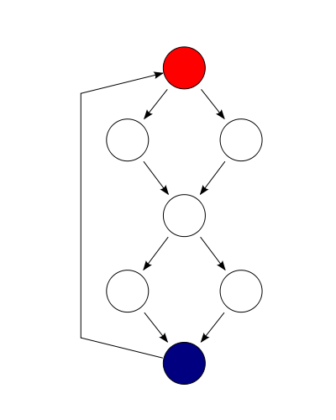
What is control flow?
It is the order in which the code executes in the program.
It is regulated by
If statements
For and while loops
Functions
Python Control flow Syntax makes
use of colons and indentations.

Slide 3
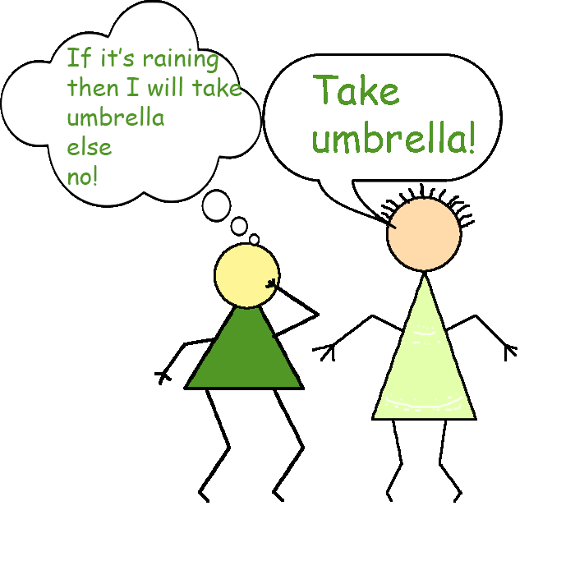
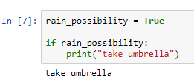
If Statement
Syntax
if expression/condition:
statement
Notice the statement is intendent further than the if statement
Notes:
rain_possibility = True
if rain_possibility:
print("take umbrella")

Slide 4
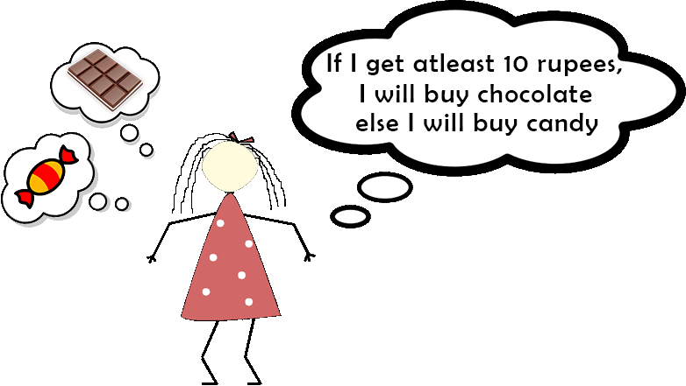
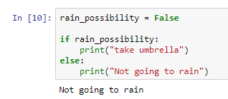
If/else Statement
Syntax
if expression/condition:
statement_1
else:
statement_2
Notes:
rain_possibility = False
if rain_possibility:
print("take umbrella")
else:
print("Not going to rain")

Slide 5
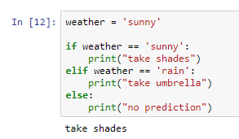
Multiple If/else Statement
Syntax
if expression/condition:
statement_1
elif expression/condition:
statement_2
else:
statement_3
Notes:
weather = 'sunny'
if weather == 'sunny':
print("take shades")
elif weather == 'rain':
print("take umbrella")
else:
print("no prediction")

Slide 6

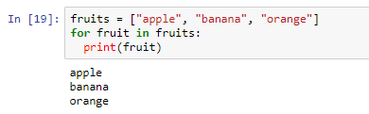
For Loop
For loop is used to iterate over elements in a sequence
for item in items:
Print(item)
Notes:
fruits = ["apple", "banana", "orange"]
for fruit in fruits:
print(fruit)

Slide 7
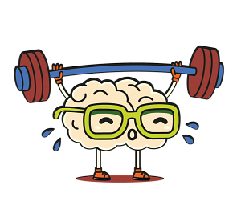
Learning Exercise 01
Iterate through the list below and print if the
element is even or odd
my_list=[1,2,3,4,5,6,7,8,9,10]
Expected output:
1 – odd
2 – even
3 – odd
…
…

Slide 8

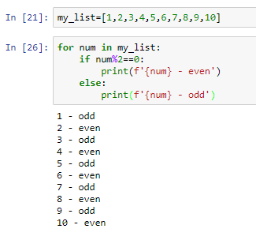
Solution
Notes:
for num in my_list:
if num%2==0:
print(f'{num} - even')
else:
print(f'{num} - odd')

Slide 9

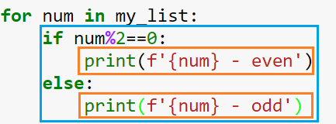
Indentation is very important

Slide 10

Iterate list inside a list - For Loop
How do you iterate nested lists??
Let's take an example
my_list =[(1,2),(3,4),(5,6),(7,8),(9,10)]
What is this? Have you seen this before?

Slide 11
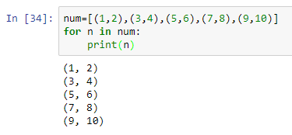
Iterate list inside a list - For Loop
(a,b) – it is nothing but a Tuple
Let's iterate this!!
Okay cool!!!
But how do we get the individual elements?
Notes:
num=[(1,2),(3,4),(5,6),(7,8),(9,10)]
for n in num:
print(n)

Slide 12
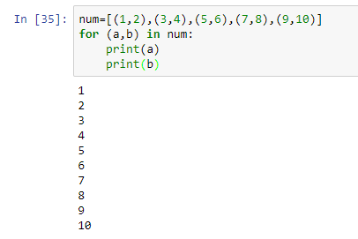
Iterate list inside a list - For Loop
Simple! Make that temporary variable just like the tuple
To simplify we can just say
for a,b in num:
Notes:
num=[(1,2),(3,4),(5,6),(7,8),(9,10)]
for (a,b) in num:
print(a)
print(b)

Slide 13
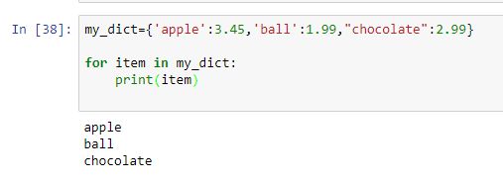
How do we iterate through dictionary?
my_dict={'apple':3.45,'ball':1.99,"chocolate":2.99}
Let's iterate it normally
But we got only the key!!! How do we get the value from the dictionary?
Notes:
my_dict={'apple':3.45,'ball':1.99,"chocolate":2.99}
for item in my_dict:
print(item)

Slide 14
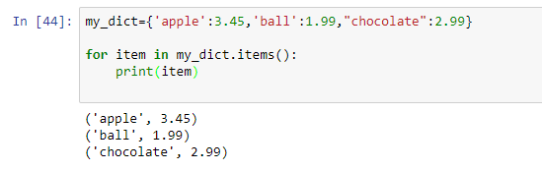
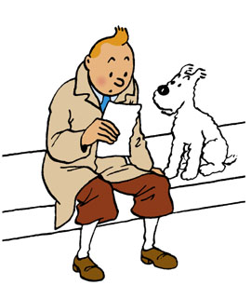
How do we iterate through dictionary?
To get values we iterate the dictionary items
for item in my_dict.items():
The Item we got is a tuple which means we can use the same method to access the individual elements
Give it a try….
Notes:
my_dict={'apple':3.45,'ball':1.99,"chocolate":2.99}
for item in my_dict.items():
print(item)

Slide 15
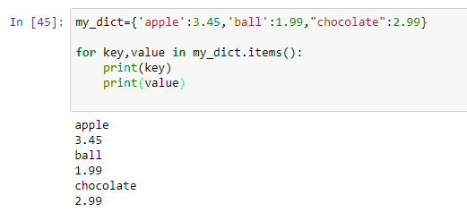
How do we iterate through dictionary?
Notes:
my_dict={'apple':3.45,'ball':1.99,"chocolate":2.99}
for key,value in my_dict.items():
print(key)
print(value)

Slide 16
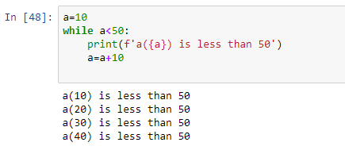
While loop
In while loop statement will execute while condition remains true
Syntax
While condition:
Statement
Notes:
a=10
while a<50:
print(f'a({a}) is less than 50')
a=a+10

Slide 17
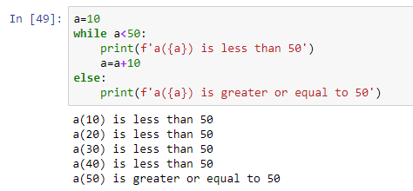
While loop
We can also combine else statement with while
Notes:
a=10
while a<50:
print(f'a({a}) is less than 50')
a=a+10
else:
print(f'a({a}) is greater or equal to 50')

Slide 18
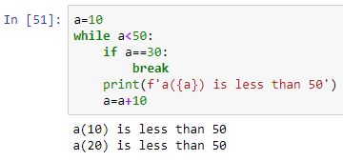
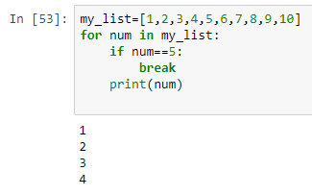
Break statement
Break out of the current closest enclosing loop
Notes:
#while loop
a=10
while a<50:
if a==30:
break
print(f'a({a}) is less than 50')
a=a+10
#for loop
my_list=[1,2,3,4,5,6,7,8,9,10]
for num in my_list:
if num==5:
break
print(num)

Slide 19
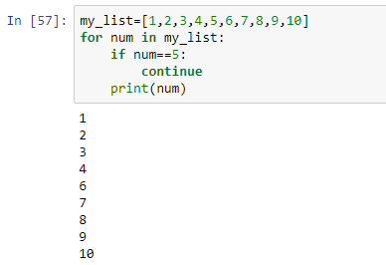
Continue statement
Goes to the top of the closest enclosing loop
Notes:
my_list=[1,2,3,4,5,6,7,8,9,10]
for num in my_list:
if num==5:
continue
print(num)

Slide 20
Learning Exercise 02
Try to iterate through a string
Iterate through your name and display the results

Slide 21
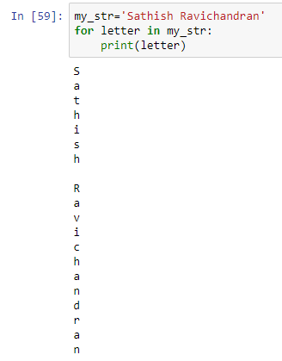
Solution
Q: How do you display index position in a string?
Notes:
my_str='Sathish Ravichandran'
for letter in my_str:
print(letter)

Slide 22
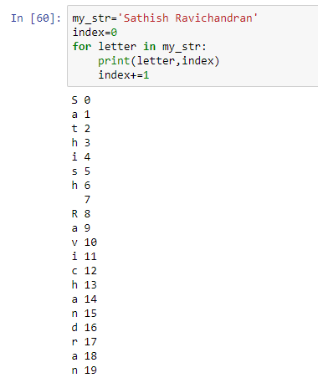
Display index position in String
Traditional method:
Notes:
my_str='Sathish Ravichandran'
index=0
for letter in my_str:
print(letter,index)
index+=1

Slide 23
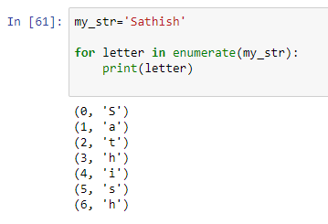

Display index position in String
Because it is a common operation Python built in enumerate function:
It’s a tuple
And we know how to get value from tuple
Notes:
my_str='Sathish'
for letter in enumerate(my_str):
print(letter)

Slide 24
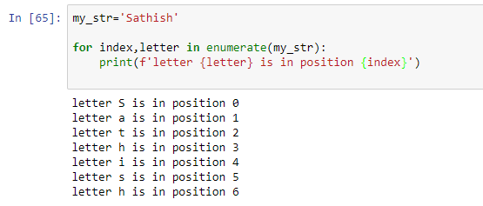
Display index position in String
Notes:
my_str='Sathish'
for index,letter in enumerate(my_str):
print(f'letter {letter} is in position {index}')

Slide 25
Thank you
The Capacity to learn is a gift;
The ability to learn is a skill;
The willingness to learn is a choice.
-Brian Herbert

